Slide 1



Aerospike High Efficiency Nozzle
Luca Robbins
Mentor: Dr. Matthew Peet
Sun Devil Rocketry
NASA Space Grant Symposium
April 13, 2019

Slide 2
What Has Been Done
Problem
Process
Rockets are expensive and inefficient
Staged rockets are big and hard to lift off the ground
Rocket engines and nozzles operate at extremely high temperatures
Design of nozzle shape
CAD Modeling
Fluid Flow Analysis
Control System Design

Slide 3
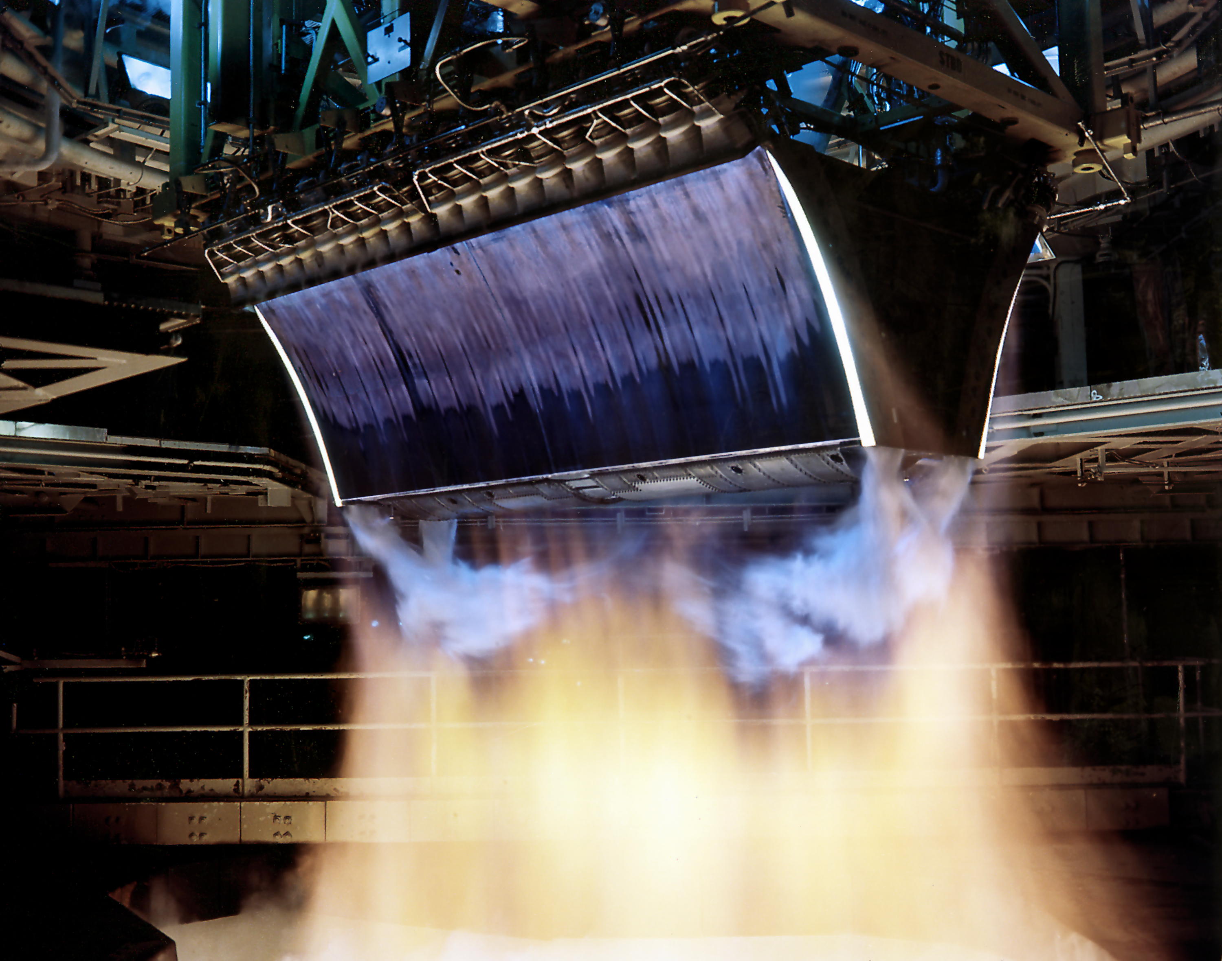
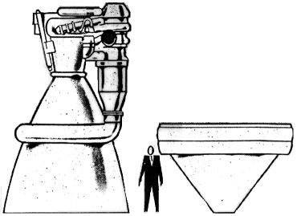
Why Aerospike?
PD-USGov-NASA (original), Creative Commons Attribution-Share Alike 3.0 Unported
Higher efficiency throughout flight better than bell nozzle
Altitude compensation feature
Weight savings
Ideal Expansion of Exhaust gases
Researchgate.net

Slide 4
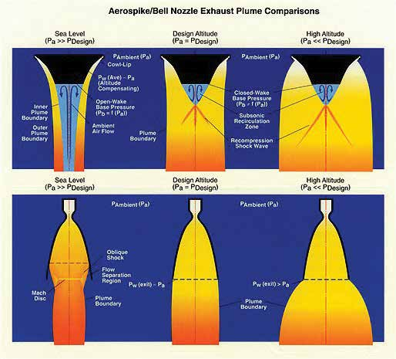
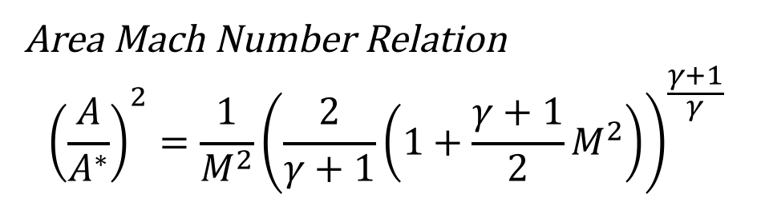
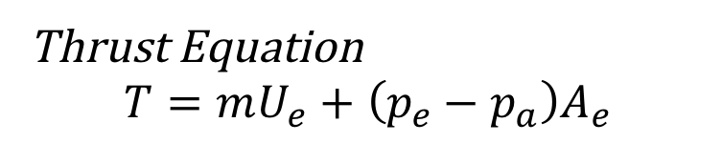
Nozzle Design
Thrust Equation
$$T=mU_{e}+\left(p_{e}−p_{a}\right)A_{e}$$
Area Mach Number Relation
$${\left(\frac{A}{A^{∗}}\right)}^{2}=\frac{1}{M^{2}}{\left(\frac{2}{γ+1}\left(1+\frac{γ+1}{2}M^{2}\right)\right)}^{\frac{γ+1}{γ}}$$
Truncated Toroidal Aerospike
Ideal Expansion
Exhaust benefits
Altitude compensation
DSIAC.org Defense Systems Information Analysis Center

Slide 5
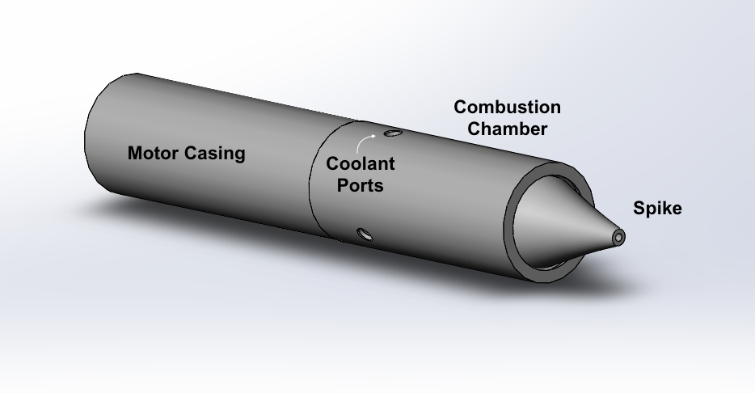
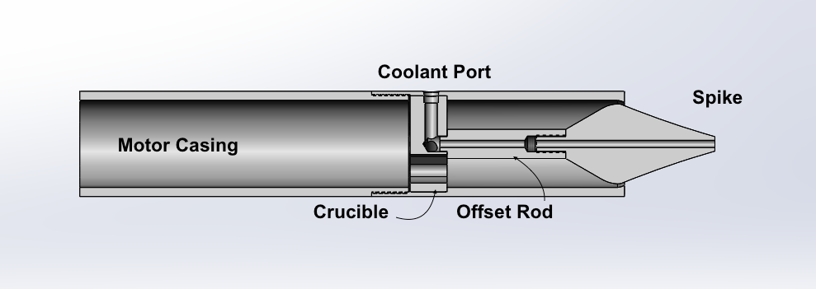
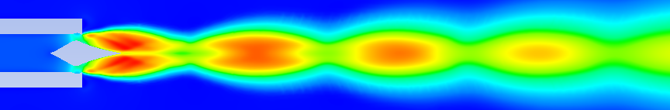
Modeling
Design centers around spike
Multiple design iterations
Primarily designed for solid fuel
Threads and O-rings
Flow Simulation
Mach Number
0
1
3

Slide 6
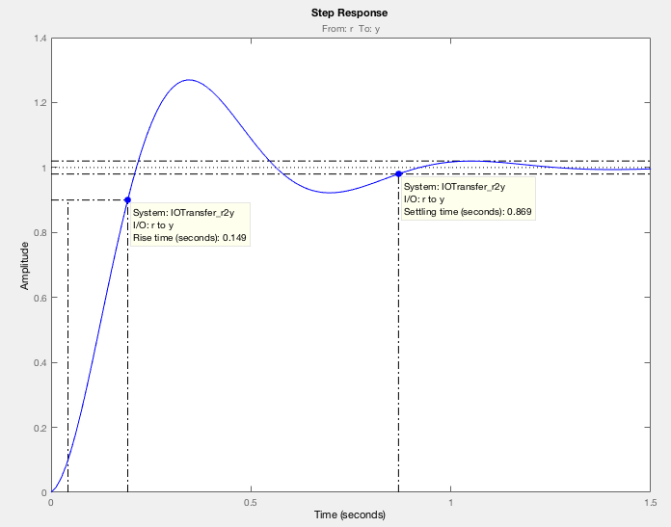
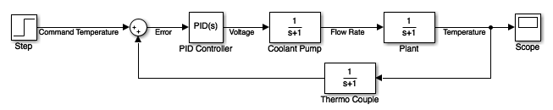
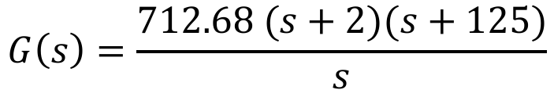
Cooling Controls
$$G\left(s\right)=\frac{712.68 (s+2)(s+125)}{s}$$
Proportional Integral Derivative controller
Proportional- Gets closer to desired output
Integral- Closes steady state error fast
Derivative- Quick response to changes

Slide 7
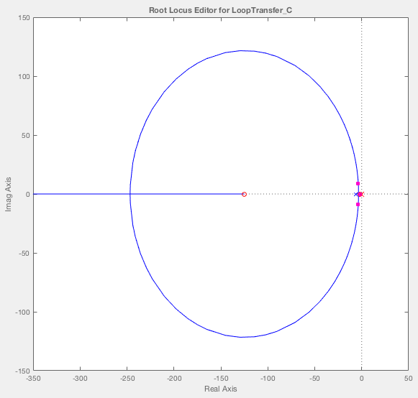
Layout and
Response

Slide 8
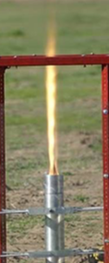
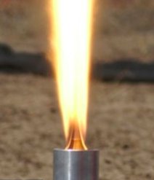
Testing
Planned Tests – HTPB Propellant
Data
Conventional Bell Nozzle control test
Aerospike Nozzle with Coolant System
Aerospike Nozzle w/out Coolant System
3 test fires for each case
Measuring thrust (load cell)
Chamber pressure (Pressure Transducer)

Slide 9
Thank you!
Questions?

